Slide 1
CHAPTER 8:
REACTION KINETICS

Slide 2

The time taken for different chemical reaction to be completed varies.
Time taken for the completion of a chemical reaction is an indication of the rate of reaction.
The shorter the time, the faster the rate of reaction
The longer the time, the slower the rate of reation
Rate of reaction is proportion to the time taken;
Rate α
1
time

Slide 3
Mathematically, the rate of reaction is defined as the rate of change in the in the concentration of reactants (or products) with time.
The unit for rate of reaction is usually mol dm⁻³ s⁻¹

Slide 4
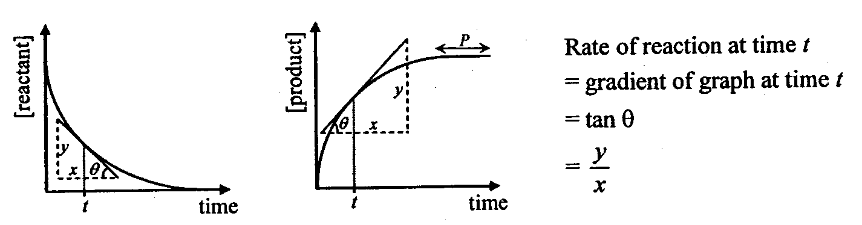
The rate of reaction can be measured by the gradient (tangent line) of a concentration vs time graph.
The steeper the gradient, the faster is the reaction.
When gradient = 0, rate of reaction is zero (reaction stopped)
Gradient decreases with time

Slide 5

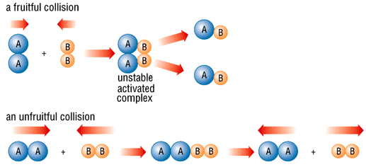
Collision theory states that...
particles must COLLIDE before a reaction can take place
not all collisions lead to a reaction
reactants must possess at least a minimum amount of energy - ACTIVATION ENERGY
plus
particles must approach each other in a certain relative way (correct orientation)- the STERIC EFFECT
Effective collision
Ineffective collision

Slide 6

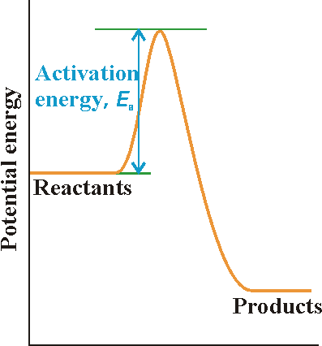
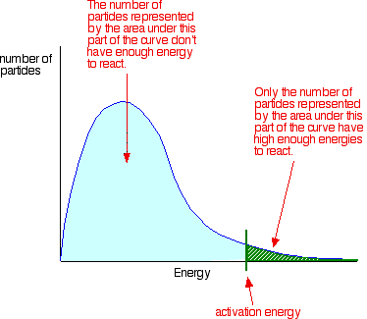
The minimum energy required for a reaction to take place when the molecules collide is called activation energy (E_{a})
Progress of reaction (time)

Slide 7

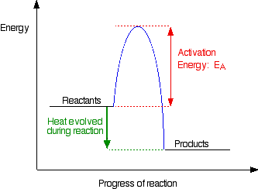
The activation energy is used to break the bonds in the reacting molecules, so that new bonds can be formed in the product.
For example, in reaction
H_{2 (g) +} I_{2 (g)} → 2HI (g)
  The activation energy is about 170 kJ per mole
  When a H₂ molecules collide with an I₂ molecule, a reaction takes place if the molecules have ≥ 170kJ
  When a reaction occurs, 170kJ of kinetic, heat and other energy is absorbed and used to break the H-H and I-I bonds
  As the H-H and I-I bonds breaks, a new bonds form. Energy is given out when a new bonds are formed.

Slide 8

According to collision theory, to increase the rate of reaction you therefore need...
more frequent collisions increase particle speed or
have more particles present
more successful collisions give particles more energy or
lower the activation energy

Slide 9
INCREASING THE RATE
The following methods may be used to increase the rate of a chemical reaction
INCREASE THE SURFACE AREA OF SOLIDS
INCREASE TEMPERATURE
INCREASE THE CONCENTRATION OF REACTANTS
INCREASE THE PRESSURE OF ANY GASES
USE A CATALYST

Slide 10
INCREASING SURFACE AREA
Increasing surface area increases chances of a collision - more particles are exposed
Powdered solids react quicker than larger lumps
Catalysts (e.g. in catalytic converters) are in a finely divided form for this reason
1
1
CUT THE SHAPE INTO SMALLER PIECES
1
1
3
3
SURFACE AREA
30 sq units
SURFACE AREA
54 sq units
The greater the surface area, the faster is the rate of reaction

Slide 11
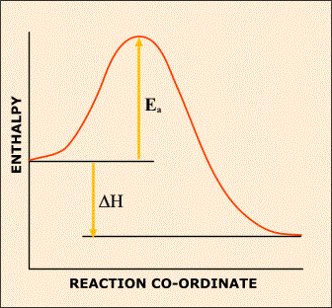
INCREASING TEMPERATURE
Effect increasing the temperature increases the rate of a reaction
more particles get more energy so they can overcome the energy barrier
particle speeds also increase so collisions are more frequent
ENERGY CHANGES
DURING A REACTION
As a reaction takes place the enthalpy of the system rises to a maximum, then falls
A minimum amount of energy is required to overcome the ACTIVATION ENERGY (E_{a}).
Only those reactants with energy equal to, or greater than, this value will react.
If more energy is given to the reactants then they are more likely to react.
Typical energy profile diagram for an exothermic reaction

Slide 12

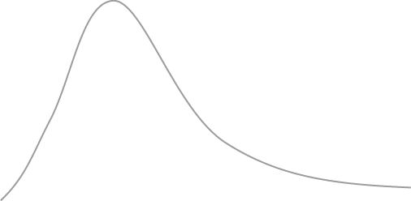
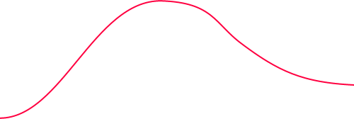
INCREASING TEMPERATURE
MAXWELL-BOLTZMANN DISTRIBUTION OF MOLECULAR ENERGY
T₁
NUMBER OF MOLECUES WITH
A PARTICULAR ENERGY
T₂
TEMPERATURE
T₂ > T₁
MOLECULAR ENERGY
Increasing the temperature alters the distribution
There is an increase in the proportion of molecules with energy equal to or greater than the activation energy required by the reaction
area under the curve (the whole) stays constant - it corresponds to the total number of particles

Slide 13
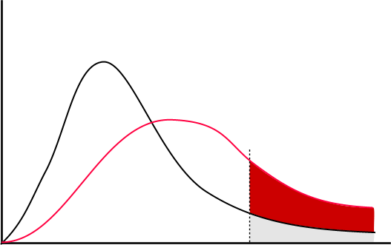
INCREASING TEMPERATURE
MAXWELL-BOLTZMANN DISTRIBUTION OF MOLECULAR ENERGY
TEMPERATURE
T₂ > T₁
T₁
NUMBER OF MOLECUES WITH
A PARTICULAR ENERGY
T₂
EXTRA MOLECULES WITH SUFFICIENT ENERGY TO OVERCOME THE ENERGY BARRIER
E_{a}
MOLECULAR ENERGY
Explanation
increasing the temperature gives more particles an energy greater than E_{a}
more reactants are able to overcome the energy barrier and form products
a small rise in temperature can lead to a large increase in rate.
A 10ºC rise of temperature will doubles the rate of reaction

Slide 14
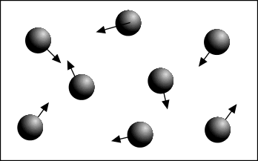
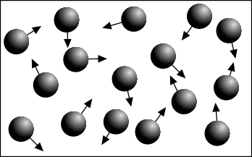
INCREASING CONCENTRATION
Increasing concentration = more frequent collisions = increased rate of reaction
Low concentration = fewer collisions
Higher concentration = more collisions
However, increasing the concentration of some reactants
can have a greater effect than increasing others

Slide 15
INCREASING THE PRESSURE
increasing the pressure forces gas particles closer together
this increases the frequency of collisions so the reaction rate increases
many industrial processes occur at high pressure to increase the rate... but
it can adversely affect the position of equilibrium and yield
The more particles there are in a given volume, the greater the pressure
The greater the pressure, the more frequent the collisions
The more frequent the collisions, the greater the chance of a reaction

Slide 16
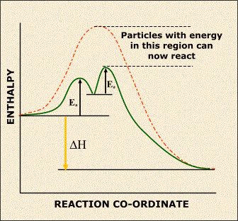
ADDING A CATALYST
Catalysts provide an alternative reaction pathway with a lower Activation Energy (E_{a})
Decreasing the Activation Energy means that more particles will have sufficient
energy to overcome the energy barrier and react
Catalysts remain chemically unchanged at the end of the reaction.
WITHOUT A CATALYST
WITH A CATALYST

Slide 17
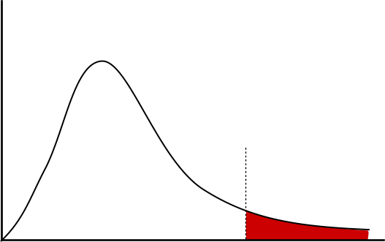
ADDING A CATALYST
MAXWELL-BOLTZMANN DISTRIBUTION OF MOLECULAR ENERGY
NUMBER OF MOLECUES WITH
A PARTICULAR ENERGY
NUMBER OF MOLECULES WITH SUFFICIENT ENERGY TO OVERCOME THE ENERGY BARRIER
MOLECULAR ENERGY
E_{a}
The area under the curve beyond E_{a} corresponds to the number of molecules with sufficient energy to overcome the energy barrier and react.
If a catalyst is added, the Activation Energy is lowered - E_{a} will move to the left.

Slide 18
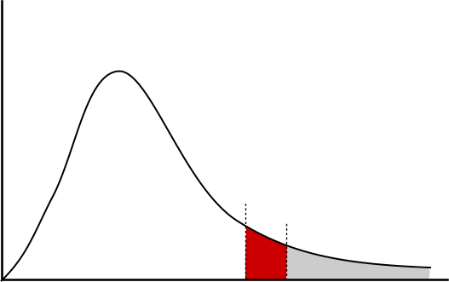
ADDING A CATALYST
MAXWELL-BOLTZMANN DISTRIBUTION OF MOLECULAR ENERGY
NUMBER OF MOLECUES WITH
A PARTICULAR ENERGY
EXTRA MOLECULES WITH SUFFICIENT ENERGY TO OVERCOME THE ENERGY BARRIER
MOLECULAR ENERGY
E_{a}
Lowering the Activation Energy, E_{a}, results in a greater area under the curve after E_{a} showing that more molecules have energies in excess of the Activation Energy

Slide 19
CATALYSTS - A REVIEW
work by providing an alternative reaction pathway with a lower Activation Energy
using catalysts avoids the need to supply extra heat – safer, cheaper and cleaner
product
catalysts remain chemically unchanged at the end of the reaction, therefore we can
reuse the catalysts and saves costs.
Types Homogeneous Catalysts Heterogeneous Catalysts
same phase as reactants different phase to reactants
e.g. Fe in Haber process
Uses: used in industry especially where an increase in temperature results in
a lower yield due to a shift in equilibrium (Haber and Contact Processes)
CATALYSTS DO NOT AFFECT THE POSITION OF ANY EQUILIBRIUM
but they do affect the rate at which equilibrium is attained
a lot is spent on research into more effective catalysts - the savings can be dramatic
catalysts need to be changed regularly as they get ‘poisoned’ by other chemicals
catalysts are used in a finely divided state to increase the surface area

Slide 20


Catalyst used is in the same physical state as the reactants.
usually in solution
Catalyst and reactants are in different physical states.
Usually catalyst are solids and reactant are liquid or gas
Reactants adsorp on surface of catalyst.

Slide 21

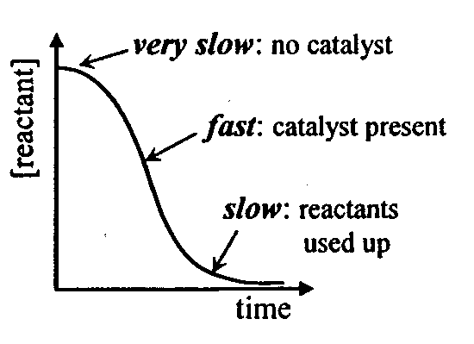
When a product acts as a catalyst in the reaction, the catalyst is said to be an autocatalyst.
An autocatalysed reaction are slow at first and then becomes more rapid as the catalyst is produced.
In most reactions, concentration of catalyst remain constant with time but in autocatalytic reaction, the concentration of catalyst increases with time. Why?

Slide 22
Example: Reaction between the ethanedioate ion and the manganate(VII) ion in the presence of dilute sulphuric acid
2MnO₄⁻ + 16H⁺ + 5C₂O₄²⁻ → 2Mn²⁺ + 10CO₂ + 8H₂O
The reaction is slow at the beginning but speed up when the Mn²⁺ ions are formed

Slide 23

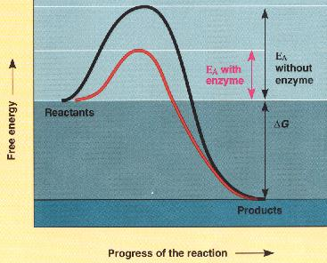
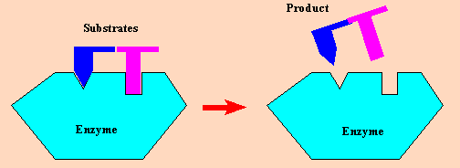
Enzymes: Special proteins that act as biological catalysts
1) Globular proteins with specialized 3-D shapes
2) Lower activation energy by
a) bringing two substrates together (greater chance
to react)
b) stress bonds of a substrate (to break them)
Substrate: The reactant/s that the enzyme binds with to in turn speed up the reaction.

Slide 24
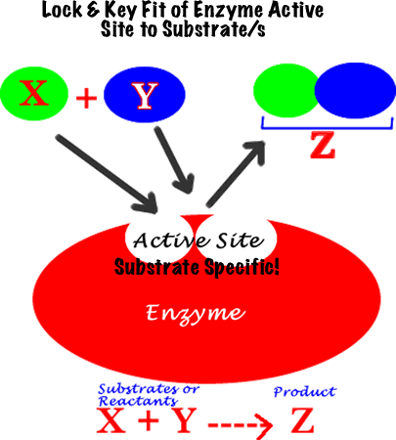
Enzymes as a Bio-Catalyst

Slide 25
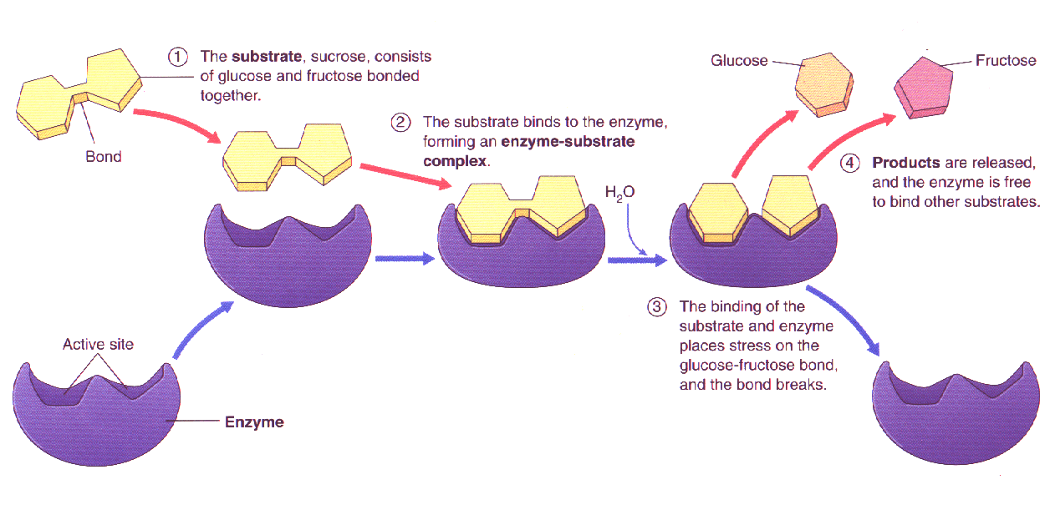
Enzymes as a Bio-Catalyst

Slide 26

Enzymes only work well within a narrow pH range (about 5 – 8)
Works in a narrow temperature range (20 – 40ºC)
Most enzymes only catalyse a very specific biochemical reaction which no other enzyme will catalyse.
Advantages of using bio-catalyst:
  Clean Product
  Saves cost and energy
  Products are specific
  Suitable for reaction that can only be run under low temperature

